Slide 1
Lesson 10: CN4005
Mental Wealth
Mental Health and Wellbeing
Dr Fadi Safieddine
1

Slide 2
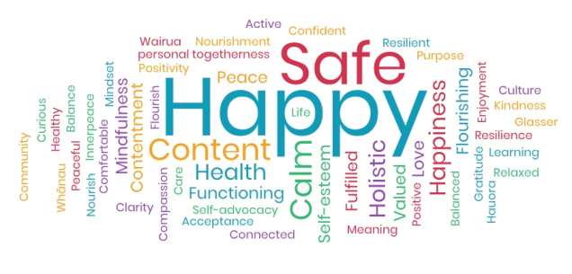
Lecture Structure
What is Stress?
Signs of Stress.
Stress response.
How to manage our wellbeing:
Three Rs
Six Steps

Slide 3
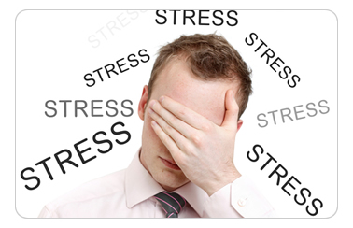
What is stress?
When the requirements of the job, university, and life are too much for you and result in physical and emotional distress.
Stress can lead to poor health, and even injury.

Slide 4
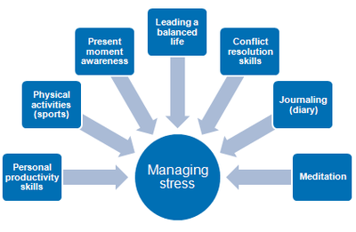
What is stress?
Stress is a natural and manageable part of life.
We react physically, mentally, and/or emotionally to various conditions, changes and demands of life.
Constant demands of academic, work, and personal life can lead to stress overload.
The stress we experience is rooted in the “fight or flight” response.

Slide 5
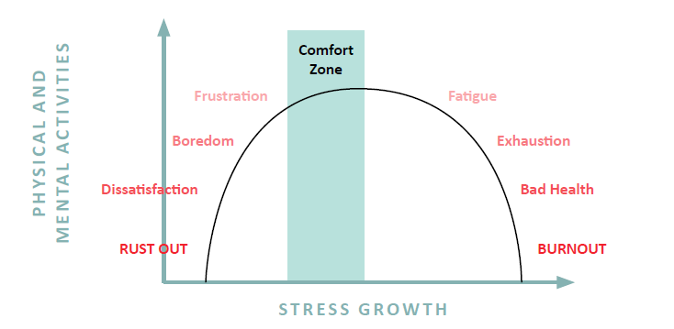
What is stress:
Karmakar, R. (2017). Guidelines for stress management. Psychology and Behavioral Science International Journal, 3(2): 555607. DOI: 10.19080/PBSIJ.2017.03.555607.

Slide 6
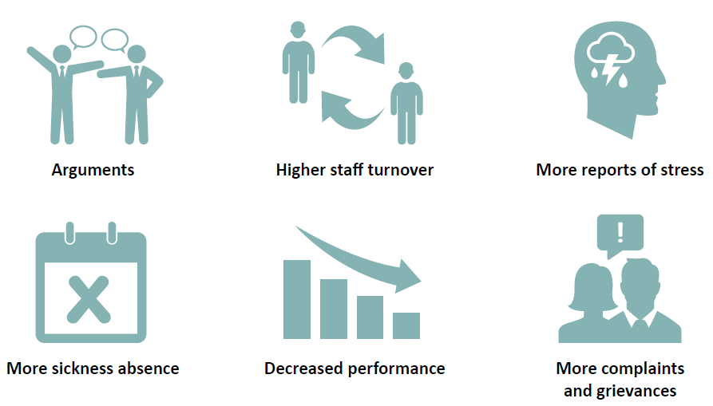
Signs for stress at work

Slide 7
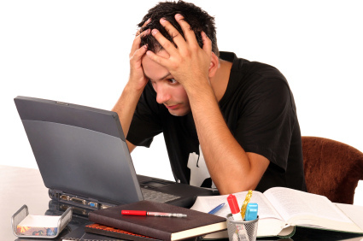
Stress response
Pay attention to how your body responds to stressful situations.
When we are stressed, our bodies respond in different ways:
Cognitive (thinking)
Emotional (feeling)
Behavioral (acting) responses to stress.

Slide 8
Stress response
The “immediate response” to a stressor is called the “fight or flight” response.
Your body gets ready to fight or flee a danger (gets ready for action).
What do you notice going on in your body
When something startles you?
This is your stress response…

Slide 9
Stress response
You may have identified any or all of the following which are potential physical responses to acute stress (your “Fight or Flight” response):
Increase in stress hormones being released into the blood stream (such as cortisol or adrenaline/epinephrine)
Increase in heart rate
Increase in blood pressure
Tense muscles
Headache
Rapid breathing (hyperventilation)
Shallow breathing, shortness of breath
Throat tightening up
Increased perspiration
Dilated pupils
Cold hands and feet
Cool skin
Dry mouth (decreased saliva)
Feelings of nausea; “butterflies in stomach”
Increased metabolic rate
Additional physical responses may include:
Stomach producing acid
Liver manufacturing blood sugar for quick energy
Blood flow shifting to muscles, away from digestive system

Slide 10
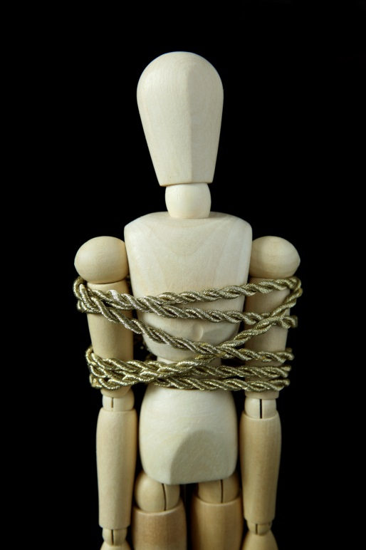
Stress response
Common signs of stress:
Blood pressure rises.
Breathing becomes more rapid.
Digestive system slows down.
Heart rate (pulse) rises.
Immune system goes down.
Muscles become tense.
Sleeping can be more of a problem.
Photo by ®Thinkstock

Slide 11
End of Part 1
Activity 10.1. How does your body react to stress? Select as many as you spot:
Blood pressure rises.
Breathing becomes more rapid.
Digestive system slows down.
Overeat
Undereat
Heart rate (pulse) rises.
Immune system goes down.
Muscles become tense.
Sleeping can be more of a problem.

Slide 12
How to manage our wellbeing?
Part 2

Slide 13
How to manage our wellbeing?
Stress is normal. It is our bodies’ response to help us prepare for challenges
In today’s world we face many situations that can trigger our stress response
We need to make sure we turn off and recover
Too much stress can be harmful
In small doses, experiencing stress can help us to perform
Workplace processes and systems can support minimizing, managing and recovering from stress

Slide 14
How to manage our wellbeing?
NO CONTROL
Circles of control
INFLUENCE
CONTROL

Slide 15
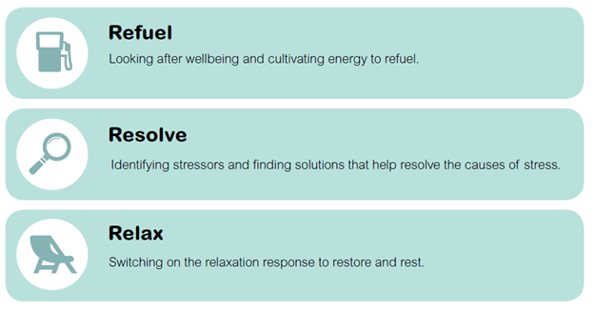
The Three Rs
How to manage our wellbeing?

Slide 16
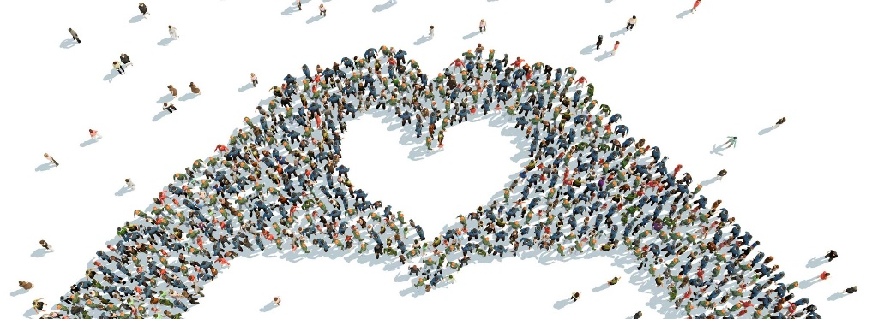
How to manage our wellbeing?
Six areas of wellbeing: 1/6
GOOD KARMA:
Take part in activities that help others:
People who help others are generally happier.
Do a random act of kindness once a week.
Do something nice for someone as often as you can.
Give time to others.

Slide 17

How to manage our wellbeing?
MANAGING STRESS: MAKING CHOICES
Six areas of wellbeing: 2/6
LEARN
Learning something helps you feel better about yourself and often gets you taking part in activities with others.
Taking part in work or educational activities particularly helps to lift people’s mood.
Set goals for yourself and work towards them in small steps, this can really help you to feel positively about yourself.

Slide 18
How to manage our wellbeing?
MANAGING STRESS: MAKING CHOICES
Six areas of wellbeing: 2/6

Slide 19
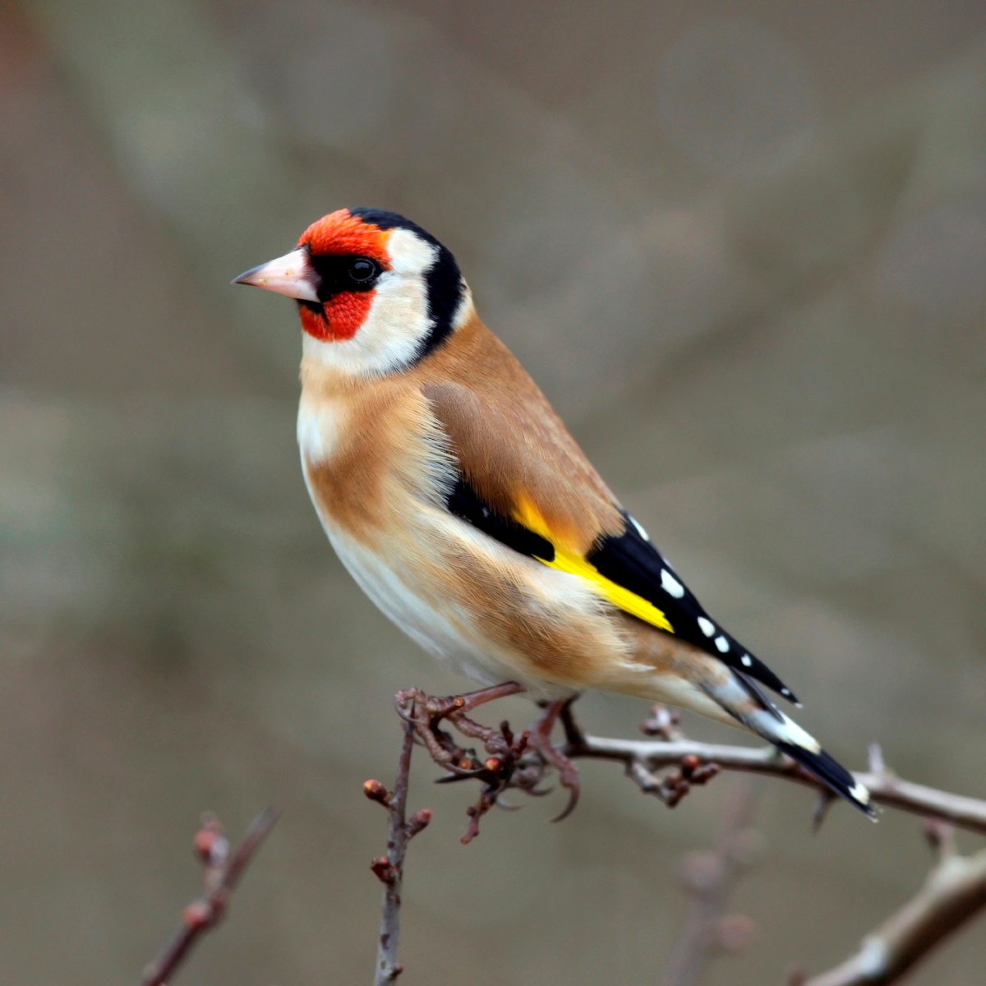
How to manage our wellbeing?
Six areas of wellbeing: 3/6
TAKE NOTICE
Remind yourself to ‘take notice’ of what’s going on around you.
Enjoy what you are doing right now, be in the moment.
Take some time to enjoy the environment around you.

Slide 20
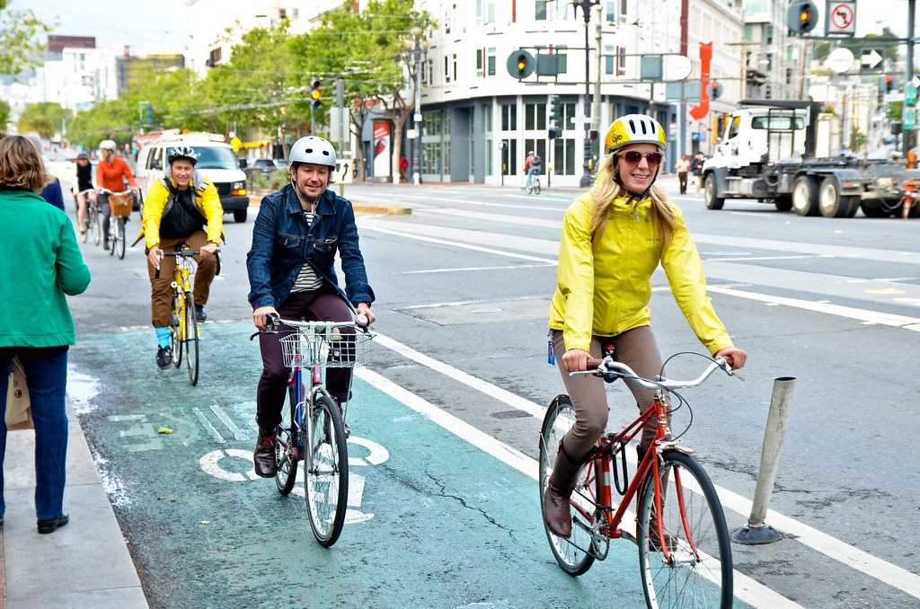
How to manage our wellbeing?
Six areas of wellbeing: 4/6
BE ACTIVE
Regular physical activity can improve mood’s and difficult feelings
Exercise is essential for promoting wellbeing.
But it doesn’t need to be hard for you to feel good – slower-paced activities, such as walking, can have benefits too.

Slide 21
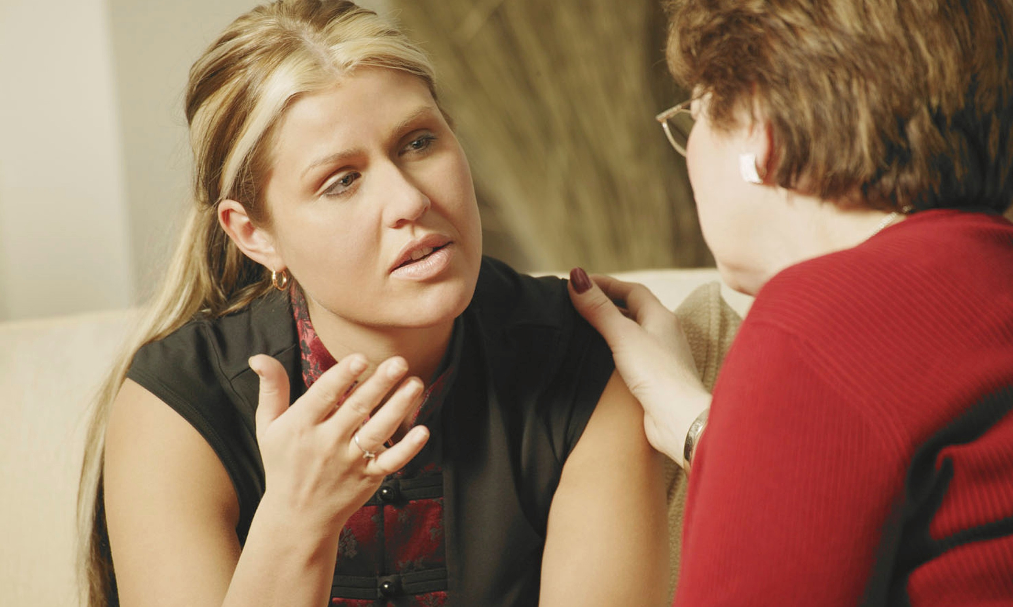

How to manage our wellbeing?
Six areas of wellbeing: 5/6
CONNECT
Find ways of being with other people and finding things in common.
Talk to others and find ways of connecting.
Connect with yourself (writing journal of thoughts)

Slide 22

RELAX: Switch relaxation response
How to manage our wellbeing?
Six areas of wellbeing: 6/6
Turning on our relaxation response puts a brake on the physical changes in our body.
Switching on your relaxation response helps focus your mind on thoughts or actions that feel good – interrupting stressful thoughts and feelings.
Basic deep breathing
Guided breathing
Progressive muscle relaxation

Slide 23
End of part 2
Activity 10.2: From the lesson today, which one of these points do you take home as a way to reduce stress (select as many as you feel useful):
Learning when to refuel (having breaks)
Identifying sources of problems.
Learning how to relax
Doing positive activities that makes you feel good.
Be active and do sports
Connect with family and friends, share concerns
Writing what is on your mind

Slide 24
Final Thoughts
Brickman, P., Coates, D. and Janoff-Bulman, R., 1978. Lottery winners and accident victims: Is happiness relative?. Journal of personality and social psychology, 36(8), p.917.
Lyubomirsky, S., 2014. The myths of happiness: What should make you happy, but doesn't, what shouldn't make you happy, but does. Penguin.

